Slide 1


RVS TECHNICAL CAMPUS-COIMBATORE
DATE:13/04/2017
DESIGN OF 90 DEGREE TURNING MECHANISM
PROJECT GUIDE: Mr. SATHISHKUMAR.K (M.E/A.PROF)
PROJECT MEMBERS:
MADHAN KUMAR . T 712913115019
NARAYANAN . S 712913115033
SANKAR . S 712913115044
YESHWANTH GURU . K 712913115065
MECHATRONICS DEPARTMENT

Slide 2
ABSTRACT
In the project the fabrication of the four wheel drive with 90 degree rotation . The project has the equipment by the following arrangements with motor, chain drive, keypad, vehicle model, battery and control unit. Project concept is very useful to reduce the parking time in shopping complex, hotels, etc

Slide 3
LITERATURE REVIEW
S.NITHYANANTH,A.JAGATHEESH,K.MADAN,
B.NIRMALKUMAR:
The steering column, which contain anuniversal joint which is part of the collapsible steering column which is designed to allow it to deviate from a straight line according to the Roadmap.
K. LOHITH, Dr. S.R.SHANKAPAL, M.H.MONISHGOWDA
If a car could automatically compensate for an understeer/oversteer problem, the driver would enjoy nearly neutral steering under varying operating conditions.

Slide 4
COMPONENTS USED
MOTOR
BATTERY
CHAIN DRIVE
SPOCKET
BEARING
CONTROL UNIT
SPUR GEAR

Slide 5
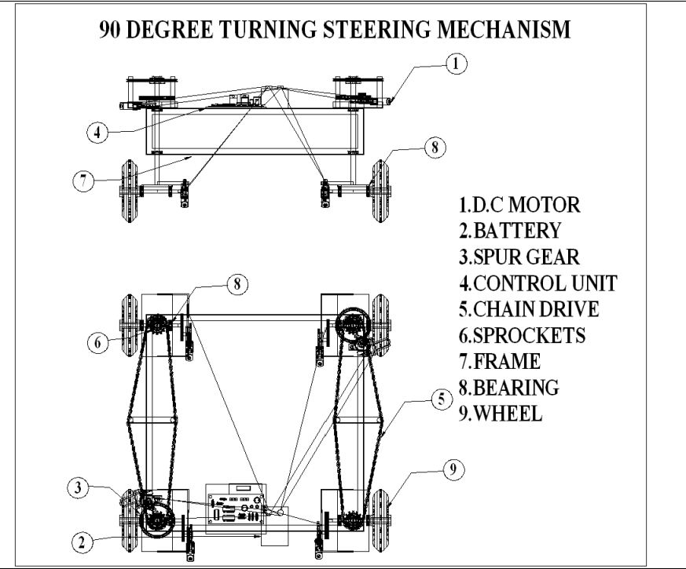
DESIGN

Slide 6
INTRODUCTION
A vehicle which can steer through 90 degrees thus reducing the turning radius with low efforts has to be defined. Automotive of present time does not have the ability to steer through 90 degrees.
The mechanism works at low speed only, The rear wheels are mounted in such a way that the power is transmitted even when it is being steered through 90 degrees.

Slide 7
WORKING
The battery provides the power supply to the control unit. The equipment contains totally six motors, two motors are coupled with the vehicle’s left and right wheels of the front side, the next two motors are connected to the vehicle’s left and right side of the back side. The four motors are used to run the vehicle. Another two motors are connected to rotate the vehicle wheel 90 degree by the chain drive arrangements.

Slide 8
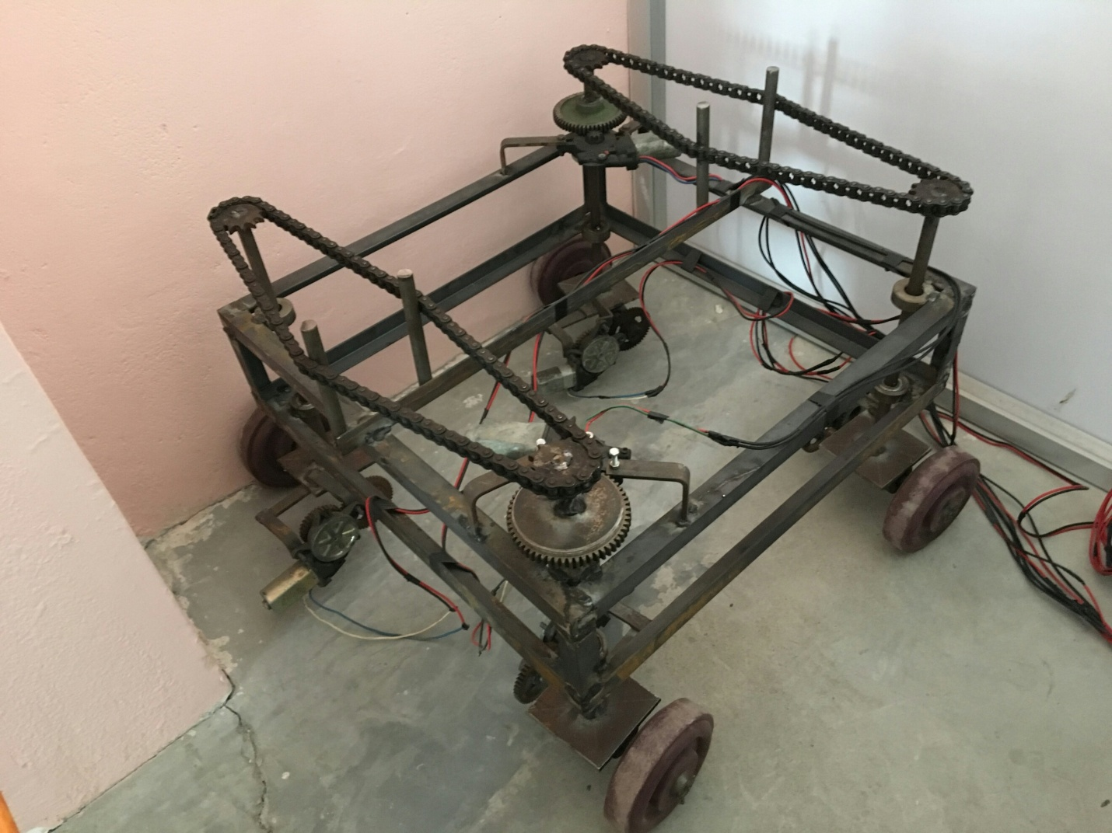
RESULT

Slide 9
CONCLUSION
90 degree steering mechanism basically helps to reduce the efforts and space required for a person to steer his vehicle. The 90 degree steering mechanism is established using rack and pinion mechanism which is feasible to manufacture, easy to set up, and highly efficient in attaining counter-phase.

Slide 10
.
THANKING YOU

